Slide 1

School Registration System
Presentation
BY JASMIN WIND
CST499: Capstone for Computer Software Technology (CSF2309A)

Slide 2

Purpose of the Project
School Registration System
SRS Document
UML Design Mode
Student Registration
Agenda
View and Update Profile
Admin Dashboard
Class Enrollment
View Schedule
PHP Code- ongoing

Slide 3
Purpose:
Schools can use this portal for:
Student Registration
Store Student profiles
Allow Students or admins to update the profiles.
Admin dashboard to add courses.
Manage student enrollments in courses.
Learning Experience to set up a system.
The School Registration System
Utilizes PHP, HTML, PHPMYADMIN and Bootstrap for styles.

Slide 4
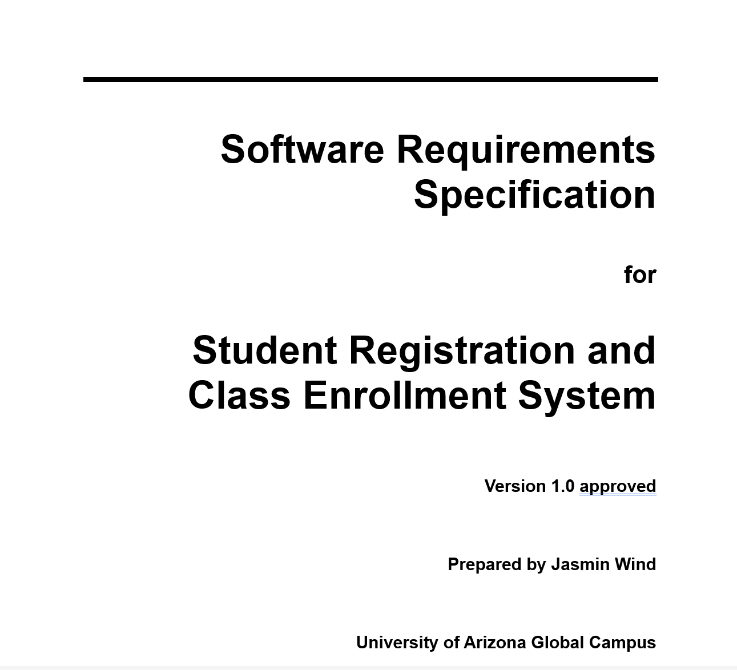
Software Requirements Specifications
SRS Document

Slide 5
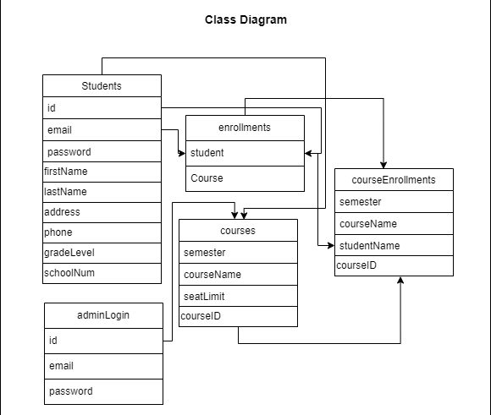
UML Diagrams

Slide 6
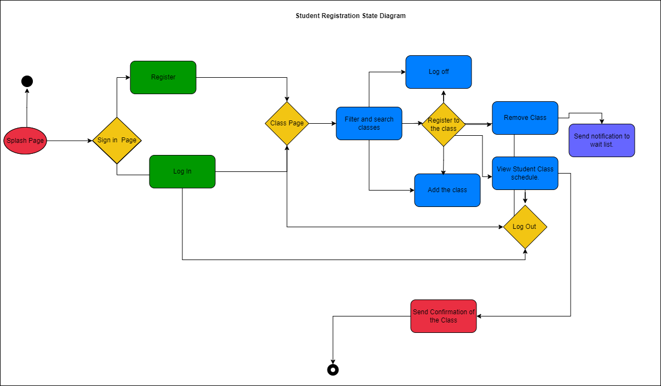
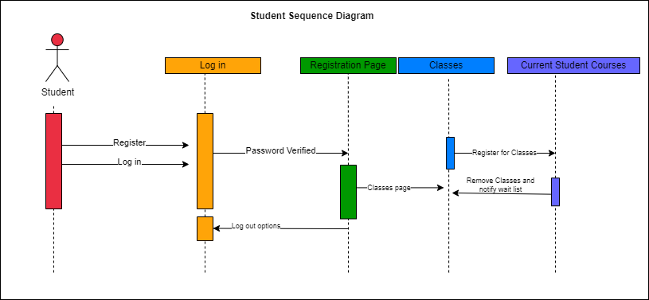
State Diagram
Sequence Diagram

Slide 7
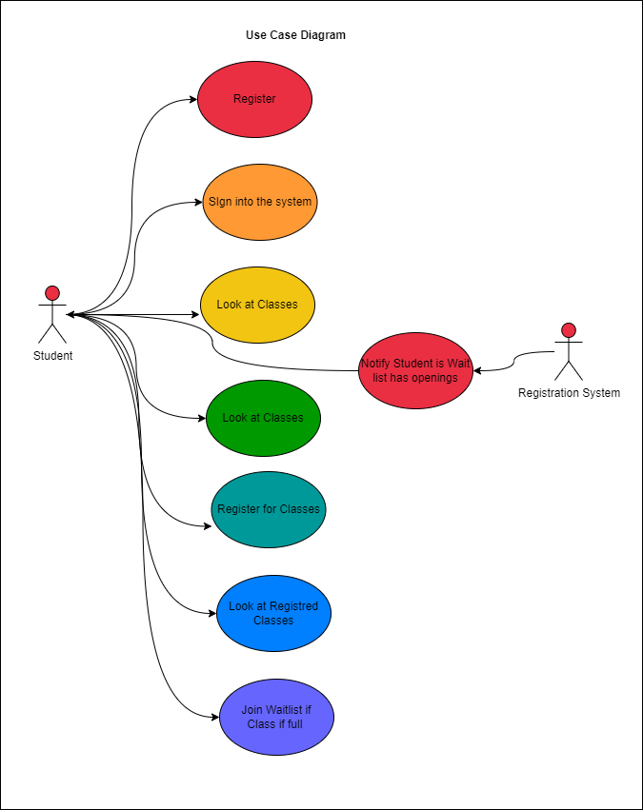
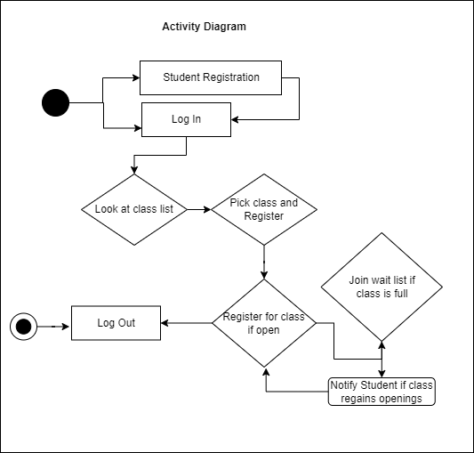
Use Case
Activity Diagram

Slide 8
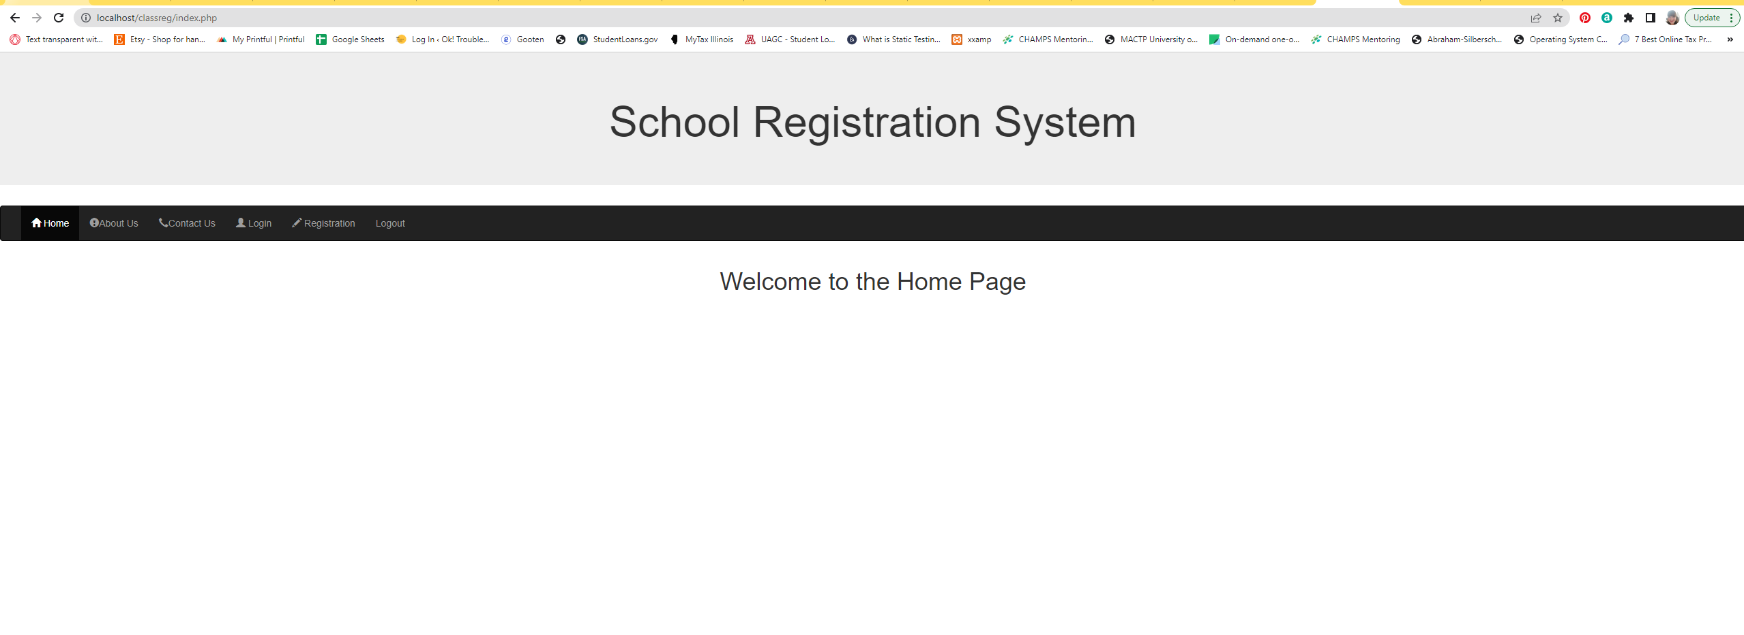
Homepage

Slide 9
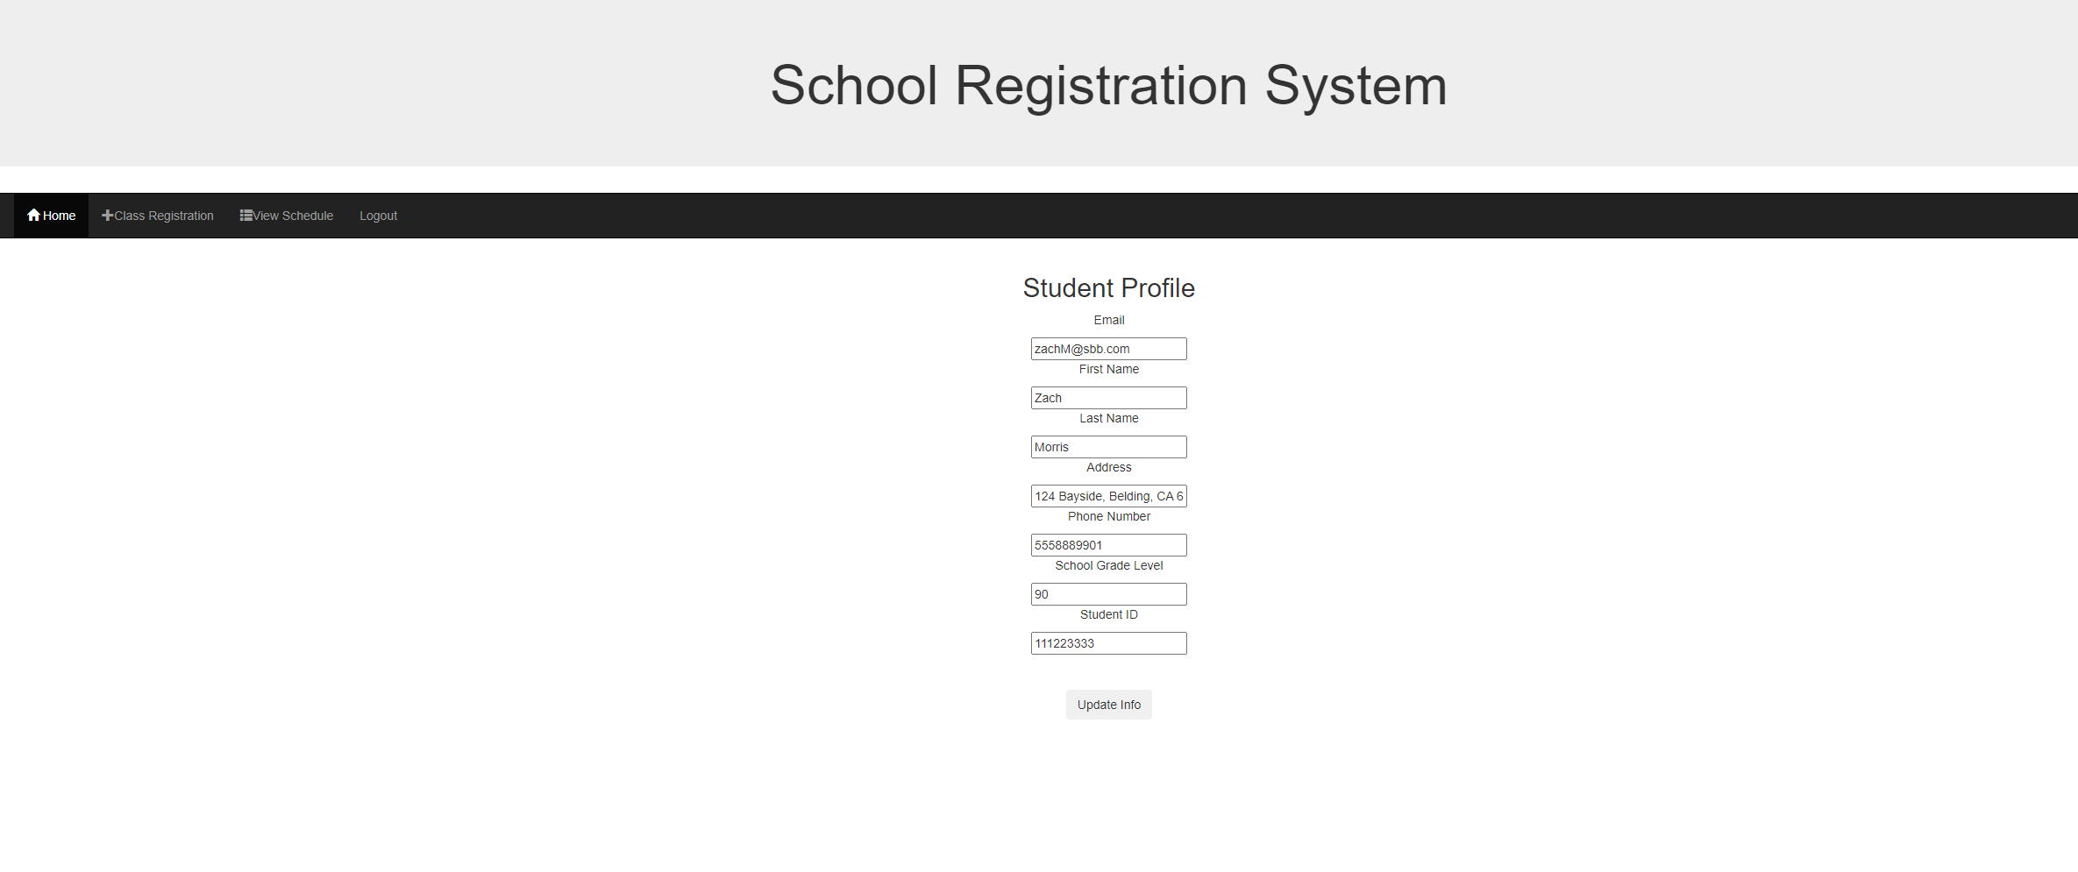
REGISTRATION
Students can register
VIEW PROFILE
Students can view their profile
UPDATE PROFILE
Students can update the information or the password

Slide 10
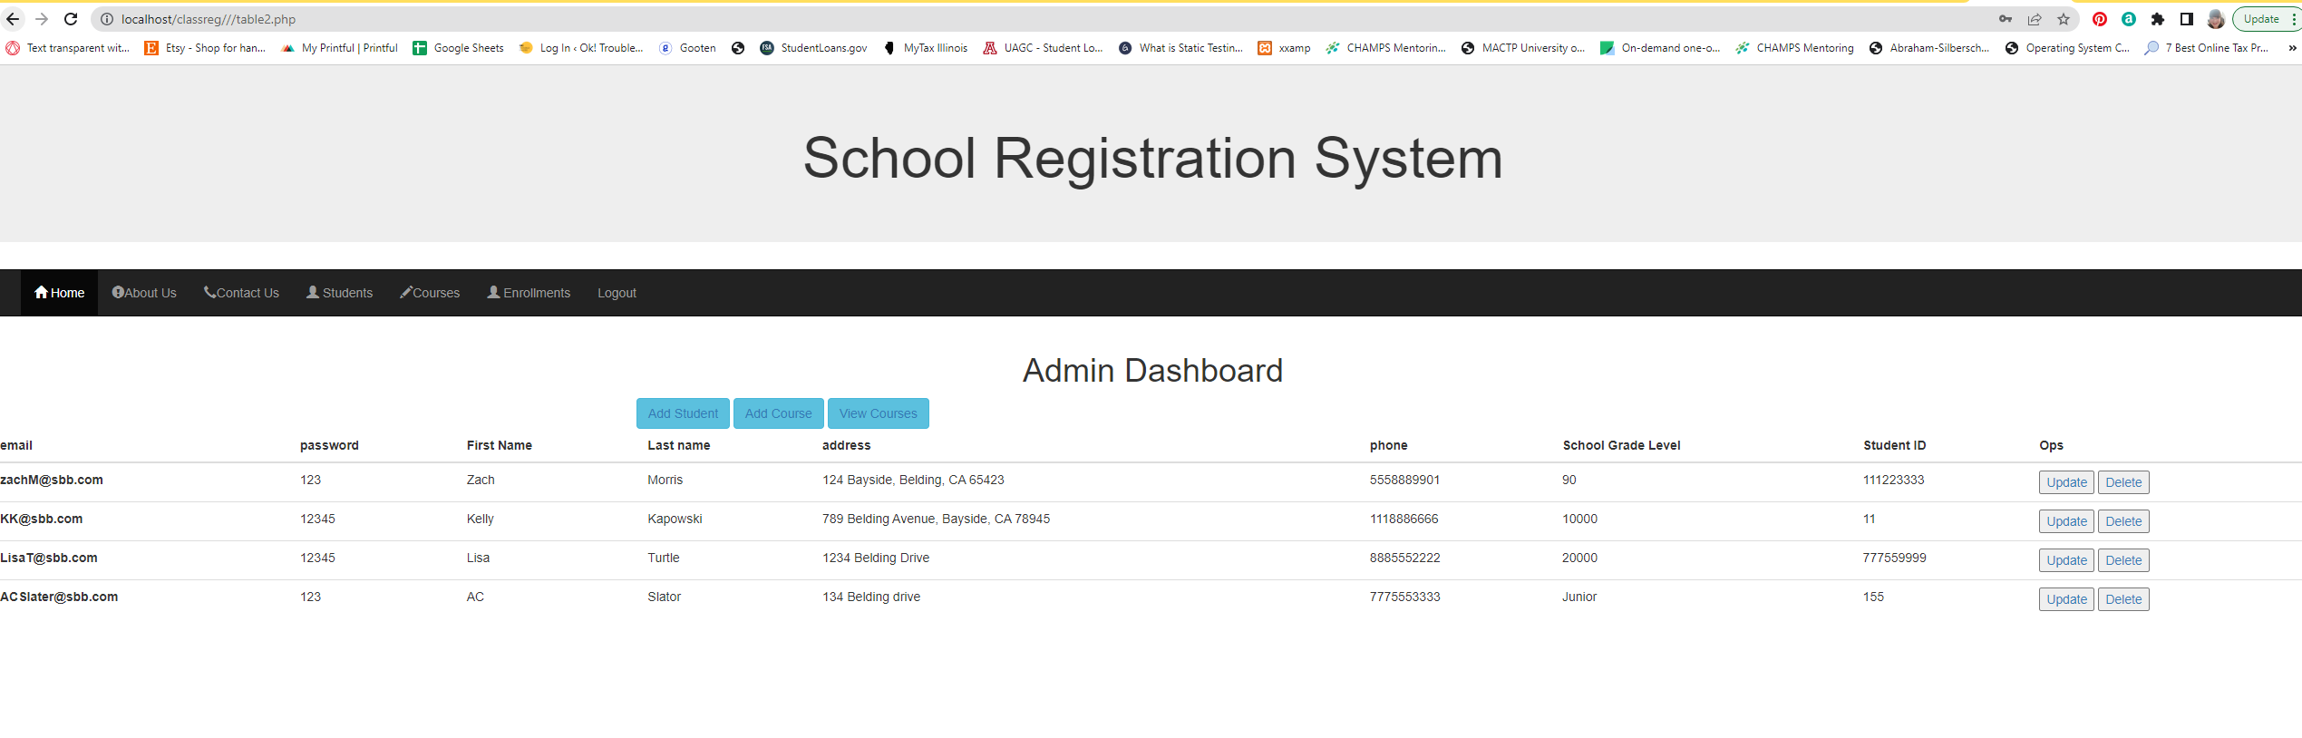
Admin Dashboard
The admin can sign in and see the Student profiles, register a student if needed, add courses and view enrollments.
Admin

Slide 11
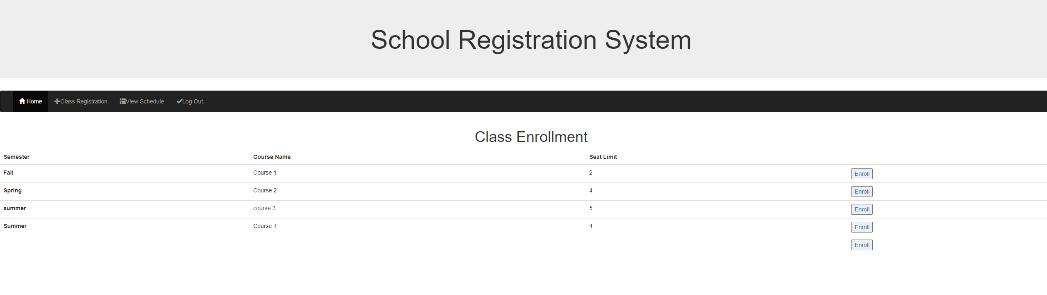
Class Enrollment & View Schedule
The student can sign out.

Slide 12
The End
THANKS FOR VIEWING THIS PRESENTION

Slide 13
References
Employee Management System in PHP. (2020, September 11). Retrieved from
1sourcecodr.blogspot.com: https://1sourcecodr.blogspot.com/2020/09/employee-managementsystem-in-php-mysql.html
geeksforgeeks.org. (2022, July 22). HTML form Tag. Retrieved from geeksforgeeks.org: https://www.geeksforgeeks.org/html-form-tag/
getbootstrap.com/. (n.d.). Buttons. Retrieved from getbootstrap.com/: https://getbootstrap.com/docs/5.2/components/buttons/
getbootstrap.com/. (n.d.). Tables. Retrieved from getbootstrap.com: https://getbootstrap.com/docs/4.0/content/tables/
stackoverflow.com. (2013, Augst 13). PHP parse/syntax errors; and how to solve them. Retrieved from stackoverflow.com: https://stackoverflow.com/questions/18050071/php-parse-syntax-errors-and-how-to-solve-them
Step, S. b. (2021, May 28). PHP CRUD || Create, Read, Update, Delete. Retrieved from youtube.com: youtube.com/watch?v=72U5Af8KUpA
W3Schools. (n.d.). PHP OOP - Classes and Objects. Retrieved from www.w3schools.com: https://www.w3schools.com/php/php_oop_classes_objects.asp

Slide 14
References Continued
www.geeksforgeeks.org/. (2022, May 19). How to Insert Form Data into Database using PHP ? Retrieved from www.geeksforgeeks.org/: https://www.geeksforgeeks.org/how-to-insert-form-data-into-database-using-php/
www.tutorialsteacher.com. (n.d.). Insert Data into Tables in SQL Server using INSERT Statement. Retrieved from TutorialsTeacher.com: https://www.tutorialsteacher.com/sqlserver/insert-data
Ycomp. (2016, Feb 29). Column count doesn't match value count at row 1. Retrieved from stackoverflow.com: https://stackoverflow.com/questions/18369252/column-count-doesnt-match-value-count-at-row-1

